Slide 1
Simple Interest
Year 10

Slide 2
Up – Talk – Down
Spend 60 seconds writing down things you would save money for, or take a loan out for
When asked, everyone will stand up, take turns to say one of your items, and then sit down once you have had your turn to speak
Notes:
Have a general discussion with the class about things to take loans for e.g. car, holiday, eventually a house
How these could all start as things to save for car, holiday, house etc.

Slide 3

24
7
30
Simple Interest
Date: / /2018
EQ – How do I calculate Simple Interest?
When you deposit money into a bank, the bank pays you interest.
When you borrow money from a bank, you pay interest to the bank.
Rate of interest
Simple interest
I = P $×$ r $×$ t
Time (in years).
Principal is the amount of money.

Slide 4
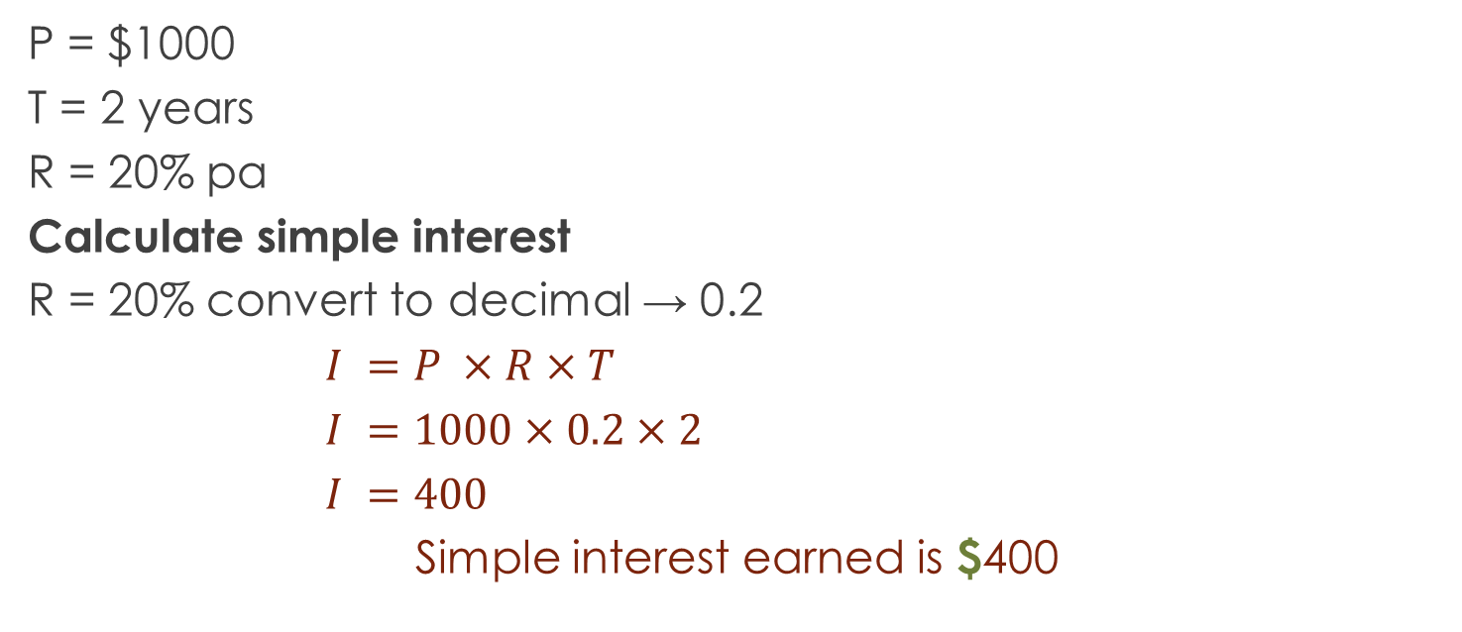
Let’s Try It Out
P = $1000
T = 2 years
R = 20% pa
Calculate simple interest
R = 20% convert to decimal → 0.2
$I =P ×R×T$
$I =1000×0.2×2$
$I =400$
Simple interest earned is $400
Now you try with a partner :
P = $1,500
T = 3 years
R= 15% p/a

Slide 5
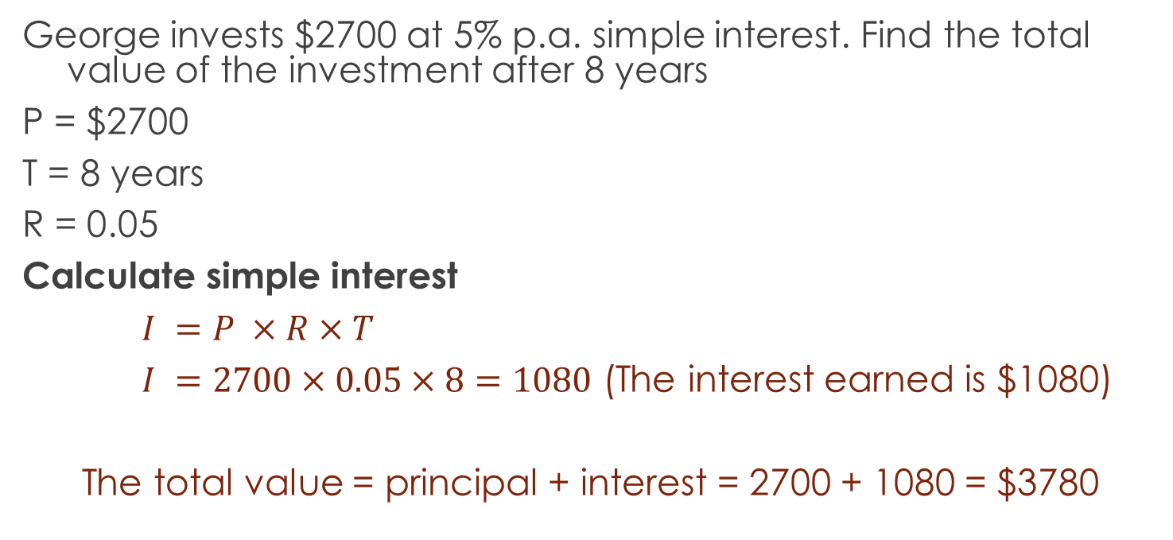
Let’s Try It Out
George invests $2700 at 5% p.a. simple interest. Find the total value of the investment after 8 years
P = $2700
T = 8 years
R = 0.05
Calculate simple interest
$I =P ×R×T$
$I =2700×0.05×8=1080$ (The interest earned is $1080)
The total value = principal + interest = 2700 + 1080 = $3780

Slide 6
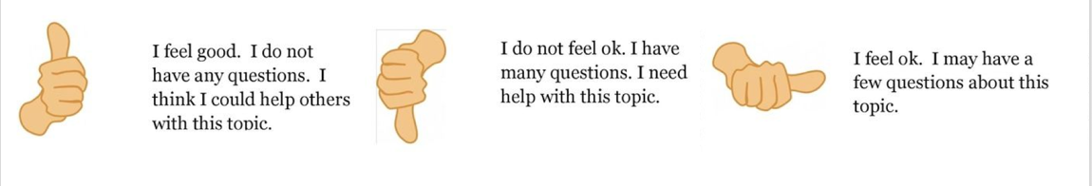
Check our understanding

Slide 7
One More To Be Sure
Ray has $750 in a savings account that pays 3% pa simple interest. How much interest will he earn in 4 years?

Slide 8
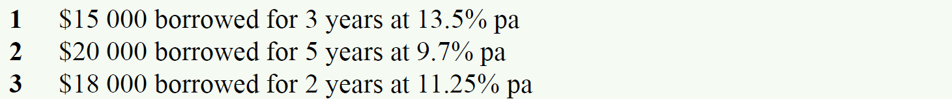
Calculate the Simple Interest

Slide 9
HomeWORK
Complete your summaries
Add new terms to your glossaries
Write your questions
24, 7, 30

